Slide 1
DO NOW
The words 'eligible', 'legible', 'ineligible' and 'illegible' are sometimes confused. In which of these sentences is one of these words used INCORRECTLY?
I regret to say that Jemima's age makes her ineligible for a scholarship.
Though untidy, Jim's handwriting is legible.
John is illegible for the prize as he doesn't meet the residence requirement.
Jane is eligible to enter the competition.

Slide 2
I know what metamorphic rocks are and how they form
I know the main properties of metamorphic rocks

Slide 3
Weekly Review
Rocks are made of ________

Slide 4
We use physical __________ to help identify minerals.
______ is the colour of a powdered mineral
______ describes how light interacts with the surface of the mineral
________ or ________ describes how a mineral breaks
______ is a useful way to identify some minerals, but can unreliable

Slide 5
____ ________ _____ allows us to compare the hardness of minerals.
Hardness | Mineral
1
2
3
4
5
6
7
8
9
10
Talc
Gypsum
Calcite
Fluorite
Apatite
Orthoclase
Quartz
Topaz
Corundum
Diamond

Slide 6
The appearance of an igneous rock is determined by:
How fast or slow it _____
Which ________ make it up

Slide 7
Cooling rate determines the ____ of the crystals:
Extrusive igneous rocks have _____crystals
Intrusive igneous rocks have _____ crystals

Slide 8
The type of minerals it contains determines the colour it will be:
Felsic igneous rocks are _____ coloured
Mafic igneous rocks are ____ coloured

Slide 9
___________ rocks are formed from materials that have been weathered, eroded, cemented and compressed.

Slide 10
Give an example of how sediment can be eroded and transported.
Wind
Water
Glaciers

Slide 11
Sedimentary rocks are made of ______, which are _________ and ________ together.
Notes:
Clasts
Compacted
cemented

Slide 12
The major identifying properties of sedimentary rocks are:
They have ______
They are made of ______
They can contain _______
They are ___ ___________
They can preserve features of the ___________
Notes:
Layers
Clasts
Fossils
Not crystalline
Environment

Slide 13
The layers that make up sedimentary rocks are called ____, or ______.
Notes:
Beds
Strata

Slide 14
The size and shape of clasts is how we give sedimentary rocks their names.
Give examples of sedimentary rocks.
Notes:
Sandstone

Slide 15
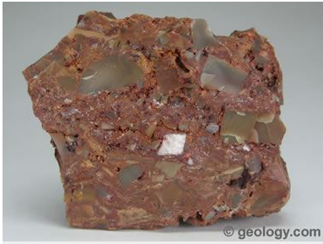
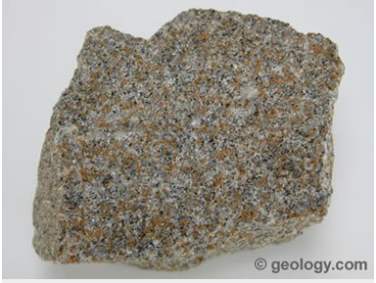
Breccia
Sandstone

Slide 16
Mineral
A naturally occurring solid substance with a definite chemical composition.
Notes:
Inorganic = not from living

Slide 17
Metamorphic
Rock that has undergone transformation by heat or pressure
Notes:
Inorganic = not from living

Slide 18
Foliation
The process of splitting into thin sheets
Notes:
Latin ‘folium’ means leaf, like pages in a book

Slide 19
Deform
Deform = change shape
Change shape = deform

Slide 20
Compacted
Compacted = compressed
Compressed = compacted

Slide 21
Property
Property = characteristic
Characteristic = property

Slide 22
I know what metamorphic rocks are and how they form
I know the main properties of metamophic rocks
Making the connection
The properties of sedimentary rocks allow us to identify them, and understanding their properties helps us to figure out how they formed.
Rocks are made of minerals
All rocks are found in the lithosphere, which is the outside layer of the Earth
There are three groups of rocks:
Sedimentary
Igneous
Metamorphic
Property – Characteristic
Mineral - A naturally occurring solid substance with a definite chemical composition.

Slide 23
I know what metamorphic rocks are and how they form
I know the main properties of metamophic rocks
What does the word metamorphic mean?
How can a rock become metamorphic?
The word metamorphic means ‘to change form’
Any rock can become a metamorphic rock if it experiences high temperatures and pressures.

Slide 24
I know what metamorphic rocks are and how they form
I know the main properties of metamophic rocks
What happens when a rock experiences high temperature and pressure conditions?
If the rock is melted, is it still going to be a metamorphic rock?
Under high temperature and pressure conditions, new minerals and textures can be formed without melting the rock.
If melting occurs, the rock becomes magma, which means the cooled rock would be igneous.

Slide 25
I know what metamorphic rocks are and how they form
I know the main properties of metamophic rocks
What are the two main groups of metamorphic rocks?
How are these two groups classified?
What are the two groups?
There are two groups of metamorphic rocks, classified by their composition and texture:
Foliated
Unfoliated

Slide 26
I know what metamorphic rocks are and how they form
I know the main properties of metamophic rocks
What is a foliated rock?
Give an example of a foliated metamorphic rock.
Foliated metamorphic rocks are those in which the minerals have been flattened and pushed down into parallel layers or bands
Examples of foliated rocks are slate, shale, schist and gneiss

Slide 27
I know what metamorphic rocks are and how they form
I know the main properties of metamophic rocks
What is an unfoliated rock?
Give an example of a unfoliated metamorphic rock.
Unfoliated metamorphic rocks are those which do not have layers.
The new crystals grow, but don’t form layers
Examples of foliated rocks are quartzite, marble and anthracite (hard coal)

Slide 28
I know what metamorphic rocks are and how they form
I know the main properties of metamophic rocks
What are the main properties of metamorphic rocks?
The main properties of metamorphic rocks are:
Many are foliated (have layering)
They are generally crystalline
They can contain fossils, but they are often deformed

Slide 29
I know what metamorphic rocks are and how they form
I know the main properties of metamophic rocks
How do we classify metamorphic rocks?
We classify metamorphic rocks by the textures it has and the minerals it contains.
These minerals and textures tell a story about the conditions the rock has experienced.

Slide 32
Prehnite-pumpellyite facies:

Slide 33
Greenschist facies:

Slide 34
Amphibolite facies:

Slide 35
Granulite facies:

Slide 36
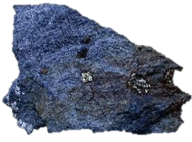
Blueschist facies:
Notes:
Glaucophane

Slide 37
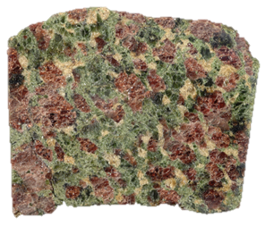
Eclogite facies:

Slide 38
Hornfels facies:

Slide 39
I know what metamorphic rocks are and how they form
I know the main properties of metamophic rocks
Why is learning about sedimentary rocks important?
Rocks tell a story – the type of rock tells you what the rock has been through and allows us to draw conclusions about how they formed.

Slide 40
I know what metamorphic rocks are and how they form
I know the main properties of metamophic rocks

Slide 41


Slide 42
